Slide 1
CampusFix: Smart Facility Maintenance Management System Prototype Development & System Integration
Stanimir Todorov, Mohamad Alkary, Kaleb Yang, Philip Valer

Slide 2

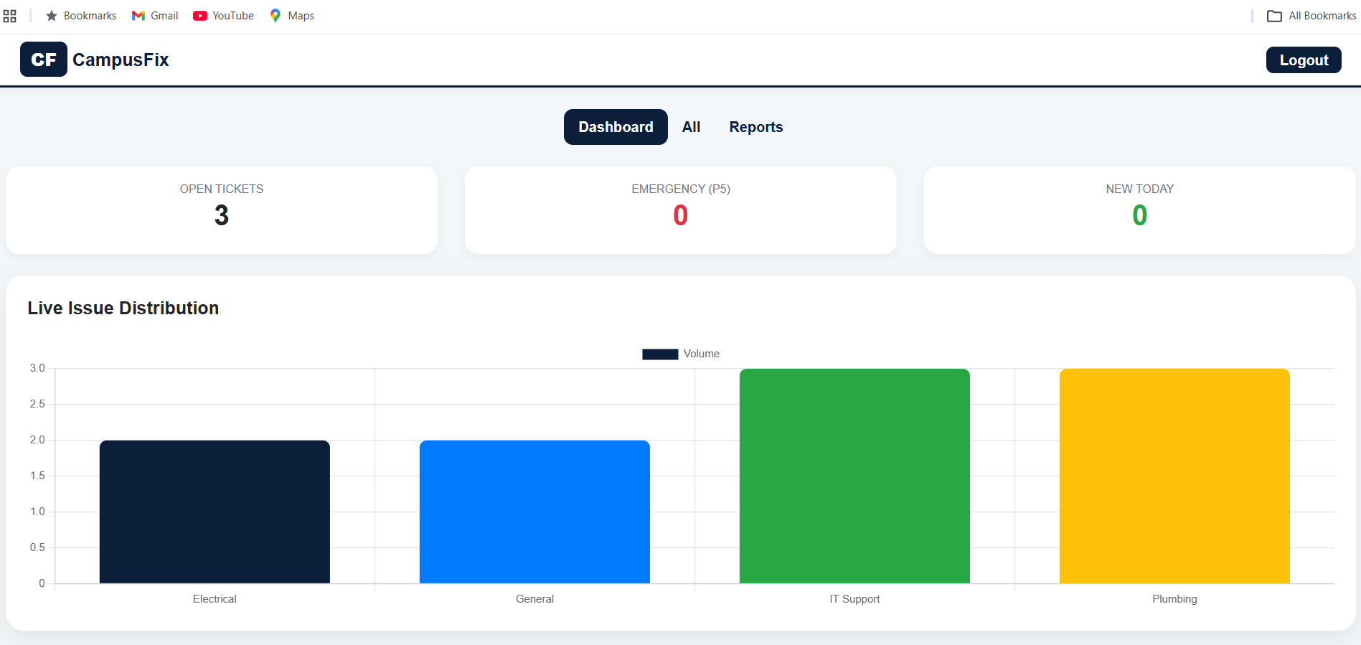
Prototype Overview (Admin Control Center)
Modernized UI/UX
Live Analytics: Integrated Chart.js to provide real-time data on issue distribution (Electrical, Plumbing, IT).
Executive Triage: High-visibility "Stat Cards" for immediate tracking of Level 5 Emergencies and daily volume.

Slide 3
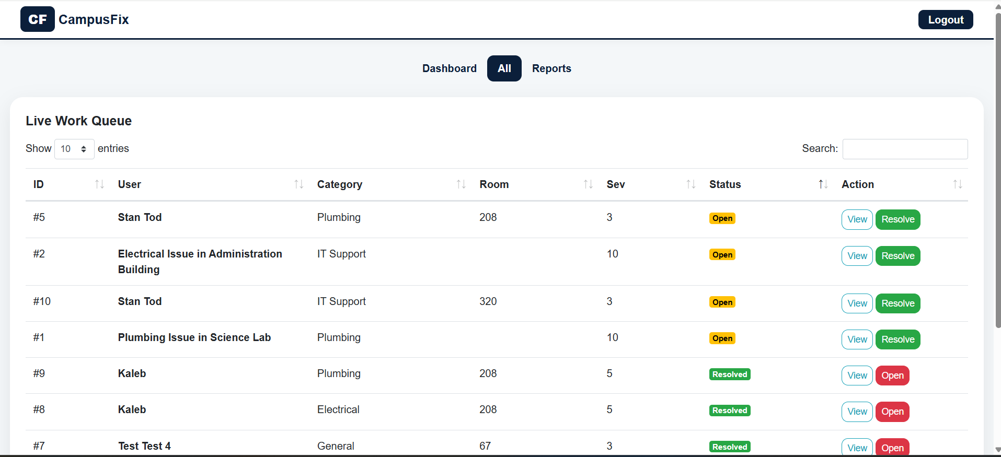
Prototype Overview (Admin Control Center)

Slide 4
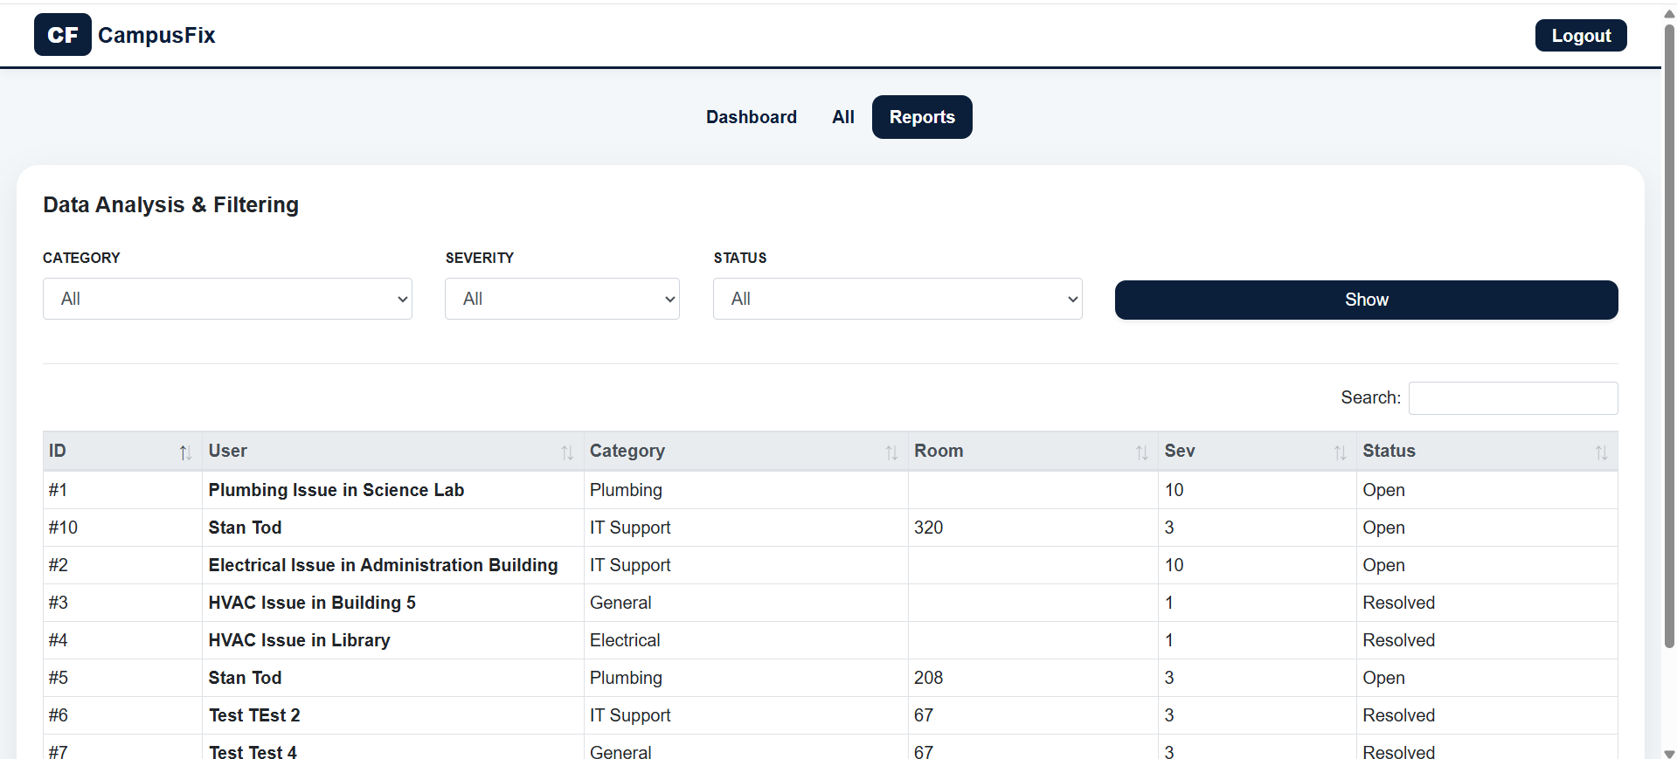
Prototype Overview (Admin Control Center)

Slide 5
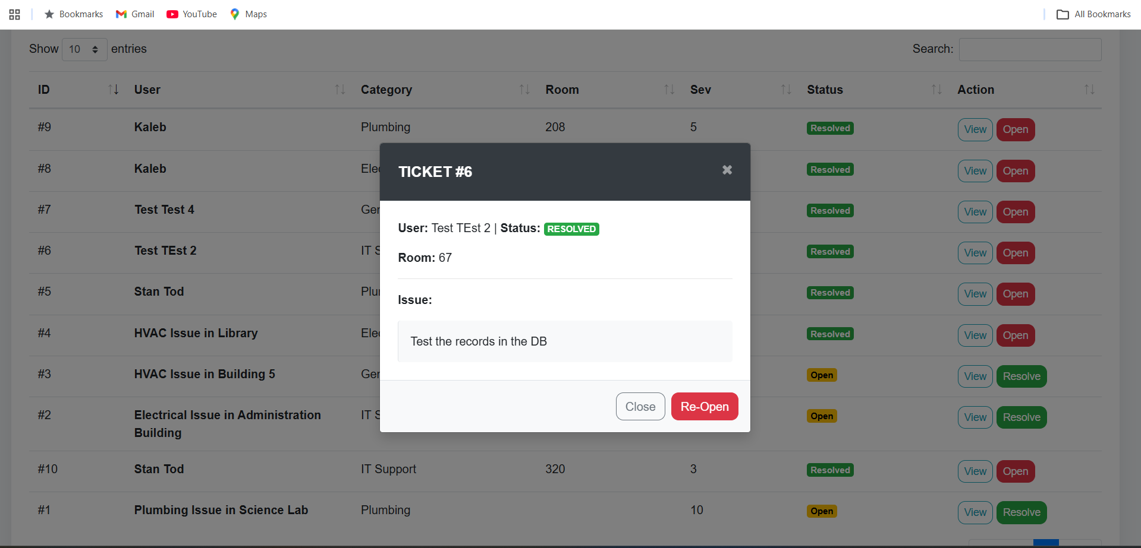
Technical Implementation
Integrated Ticket Lifecycle: Developed a centralized api/resolve_ticket.php to manage Bidirectional State Logic. This allows the system to toggle tickets between 'Open' and 'Resolved' dynamically, ensuring the database accurately reflects real-time maintenance status.
Contextual Data Access: Implemented Modals to enable ticket reviews (in case the text is too long). This allows the administrator to inspect full issue descriptions and metadata without disrupting the primary work queue or losing session state.
Database Schema Evolution: Executed a structured SQL Migration to implement categorical data tracking. This update bridges the gap between raw ticket entry and our Analytics Engine, allowing for the high-level reporting required for administrative oversight.

Slide 6
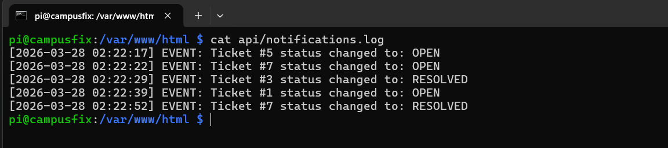
Notification Architecture and Transactional Logging
Real-Time Event Triggering: Engineered a backend trigger that captures every ticket status change. When a ticket is "Resolved" or "Re-Opened," the system instantly generates a machine-readable entry.
Audit Trail Compliance: Implemented api/notifications.log as a centralized System Audit Trail. This provides a permanent record of administrative actions, timestamps, and ticket IDs for accountability and performance tracking.
Extensible Middleware: The logging architecture serves as the Middleware layer, designed to push data to external services (like Email, SMS, or Hardware controllers) without modifying the core Dashboard code.

Slide 7
Testing - Unit & Functional
Test ID | Component | Expected Result | Status
UT-01 | resolve_ticket.php | DB updates status & returns JSON success | PASS
UT-02 | Chart.js Data | Handles NULL categories as "Unassigned" | PASS
FT-01 | Lifecycle Loop | Ticket moves Open → Resolved → Open | PASS
FT-02 | Report Triage | Filtering in Reports tab is isolated from Queue | PASS
Unit Testing: Verified individual script stability (Auth checks, DB handshakes, JSON formatting).
Functional Testing: Validated end-to-end "User Stories" (e.g., Administrator finds, filters, and resolves a ticket)..
Security Validation: Confirmed data sanitization to prevent common SQL injection vulnerabilities.

Slide 8
Roadmap to Final Submission
Category Alignment: Finalizing "Submit" page to match Admin Portal analytics.
Bug fixing
Stress Testing: Simulating 100+ concurrent tickets to verify Raspberry Pi MariaDB performance.
Documentation: "User Manual," and "System Overview."

Slide 9
GitHub https://github.com/stantod77/CampusFix-Core
Thank you!

